Slide 1

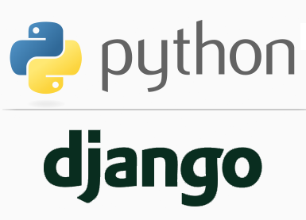
FULL STACK WEB DEVELOPMENT WITH DJANmmGO
Lecture 6

Slide 2

Today’s Agenda
Developing Our Django App
What Is An App ?
Creating An App
Default Components Of An App
Activating The App
Understanding A View
Creating A View
Configuring The URL
Running The App

Slide 3
What Is An App ?
As previously discussed , an app in Django is created to perform a particular functionality for our entire web application (Django Project)
For example we could have a Django Project(website, webapplication) called voting which could contain a registration app, a polling app, comments app, etc.
Thus every Django Project is a collection of one or more Django Apps.

Slide 4
Steps Required For Creating And Running An App
To create and run a Django app , we need to follow 6 steps assuming that we have already created the Django project which will contain this app:
Creating the app
Activating the app
Creating the View
Configuring the View in Url
Running the server
Opening the page in browser

Slide 5
Creating An App
To create an app we use the following command:
django-admin startapp appname
where appname is the name of our Django app
For example:
django-admin startapp greetingsapp
The above command has to be executed from the directory which contains the file manage.py
When we execute the above command Django will create appropriate file/folder structure for our app

Slide 6
Step 1: Creating An App
Launch VS Code and open the folder called myvsdjangoproject that we created previously.
Activate the Virtual Environment by selecting View→Command Palette→Select Python Interpreter→Python 3.7.0(vsdjango:virtualenv)
Open the terminal by selecting Terminal: New Terminal
Go to the project directory called demoproject by using the cd command and now ,type the following command:
django-admin startapp greetingsapp

Slide 7
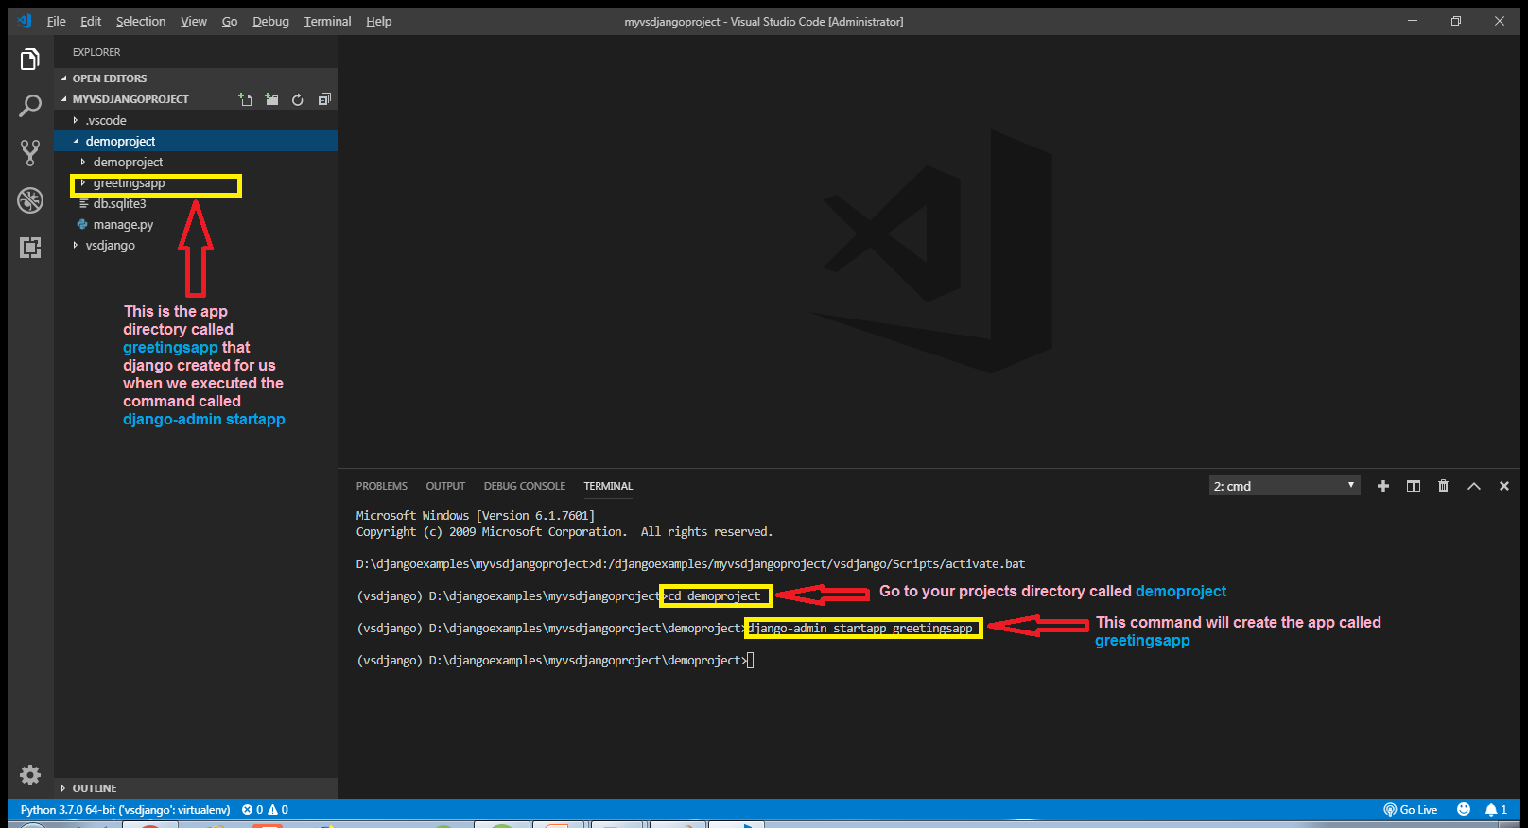
Step 1: Creating An App

Slide 8
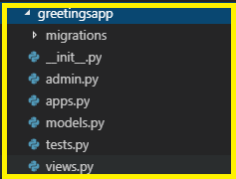
Default Components Of A Django App
Whenever we create a Django App with the command:
django-admin startapp appname
Then Django creates a particular folder/file structure which is almost same as the folder/file structure of Django project but with some new components

Slide 9
Default Components Of A Django App
Let us discuss each of them to have a better understanding:
migrations folder
This directory stores all the database migrations of our app. It is initially empty because there are no migrations present by default.
__init__.py file
This file is an empty file and it tells Python that this directory has to be treated as a Python package
A package in Python is a collection of modules and can be imported in same way like a module.

Slide 10
Default Components Of A Django App
admin.py file
This file is the configuration file for the built in admin app provided by Django. It contains all the models we need for administration app which can be used for maintaining and customizing site data.
apps.py file
This file contains application level configuration.
It contains information about classes used in our apps and other metadata.

Slide 11
Default Components Of A Django App
models.py file
This file contains all the models used by our application .
Recall that models are classes that represent database tables.
So all the tables used by our app will be represented as models in this file, with their columns declared as data members in these classes.
tests.py file
This file contains all the test functions used for testing our application’s code

Slide 12
Default Components Of A Django App
views.py file
This file is the most important file.
This is where we have functions that handle requests and return responses.
All the application logic goes here , for example, when the user clicks a button what needs to be done is coded here.

Slide 13
Step 2: Activating The App
Once we have created an app we must let Django know about it so that Django can keep track of our application and allow us to do sttuff with the app like create database tables etc.
To do this we must make an entry of our app in the INSTALLED_APPS list of the settings.py file of the default app given by Django.

Slide 14
Step 2: Activating The App
Open the settings.py file in the demoproject app of our demoproject folder and make the entry shown in green color in the INSTALLED_APPS list
Code:
INSTALLED_APPS = [
'django.contrib.admin',
'django.contrib.auth',
'django.contrib.contenttypes',
'django.contrib.sessions',
'django.contrib.messages',
'django.contrib.staticfiles',
'greetingsapp',
]
Why we are puttng an extra comma here ?
This is just a convention we use in Python and it’s useful for consistency across multiple lines

Slide 15
Understanding Views
Before creating our first webpage, let us discuss what is a view ?
A view or view function in Django is simply a Python function/method that takes a web request and generates a web response.

Slide 16
Understanding Views
A view fetches data from our database (or an external data source or service) and delivers it to a template or directly to the browser.
The view makes decisions on what data gets delivered ,either by acting on input from the user, or in response to other business logic and internal processes.

Slide 17
Understanding Views
In the early days of Django, there were only function-based views, however, as Django has grown over the years, Django’s developers added class-based views.

Slide 18
Step 3:Creating Our First View
To create our first view, we need to modify the views.py file in our greetingsapp app
Open the views.py file and write the code shown in the next slide

Slide 19
Step 3:Creating Our First View
from django.shortcuts import render
from django.http import HttpResponse
def homePageView(request):
return HttpResponse("<h1>Welcome To Sharma Computer Academy!</h1>")

Slide 20
Code Explained
from django.shortcuts import render
This line imports the render() method and is added to the file automatically by the startapp command .
The method render() is used when rendering templates.
from django.http import HttpResponse
Each view that we write is responsible for instantiating, populating, and returning an HttpResponse.
The HttpResponse class lives in the django.http module.

Slide 21
Code Explained
def homePageView(request):
return HttpResponse("<h1>Welcome To Sharma Computer Academy!</h1>")
The name of our view function is homePageView( ) .
We can give it any name we like but it should accept one argument which is called request object and belongs to the class HttpRequest
Finally our view function has to return a web response which in this case is an object of the class HttpRepsonse containing plain HTML data

Slide 22
Step 4:Configuring The Url
After creating and updating the views.py as shown in the previous slide if we start the server and access the url http://127.0.0.1:8000 , then still we will get the default Django page .
In order for Django to use our new view, we need to tell Django this is the view we want displayed when someone navigates to the site root (home page)

Slide 23
Step 4:Configuring The Url
We do this by configuring our URLs and this url configuration is done by calling the function path()

Slide 24
Step 4:Configuring The Url
In it’s basic form, the path() function has a very simple syntax:
path( route, view,[name])
For example : path(' mypage/', views.myview)
In this example, a request to http://127.0.0.1:8000/ mypage would be routed to the myview function in the application’s views.py file
The path() function also takes an optional parameter called name that we will discuss later

Slide 25
Step 4:Configuring The Url
The path() function statements are kept in a special file called urls.py.
When startproject created our Django project called demoproject , it created a urls.py file in our site folder (\ demoproject\urls.py).
This is a good place for site-wide navigation, but is rarely a good place to put URLs relating to individual applications.

Slide 26
Step 4:Configuring The Url
This is for 2 reasons:
Having all our URLs in the one file is more complex and less portable.
It also can lead to strange behavior if two applications use a view with the same name.
To solve this problem, we create a new urls.py file for each application

Slide 27
Step 4:Configuring The Url
In the VS Code create a new file called urls.py in the greetingsapp folder and write the following code in it.
Code (greetingsapp/urls.py):
from django.urls import path
from . import views
urlpatterns = [
path('', views.homePageView, name =' index'),
]

Slide 28
Code Explained
from django.urls import path
This line imports the path() function. This import is necessary for the URL dispatcher to work and is common to all urls.py files.
from . import views
Imports the local views.py file. The dot operator (“.”) in this case is shorthand for the current package

Slide 29
Code Explained
urlpatterns = [
path('', views.homePageView, name =' index'),
]
This line creates a Python list called urlpatterns which contains the URL patterns registered for this app. Make sure to use the name urlpatterns only for this list as django searches for this name only.
In our case the actual URL dispatcher is the ' ' which matches an empty string.
It will also match the “/” as Django automatically removes the slash. In other words, this matches both http:// example.com as well as the url http:// example.com/.
The argument views.homePageView points to our homePageView() function in the views.py file

Slide 30
Step 4:Configuring The Sites Main urls.py File
Whenever a request arrives it first hits the main urls.py file , that is , the file urls.py in the directory demoproject.
So we must configure this file also so that it simply redirects the request to our greetingsapp’s urls.py file whenever a request arrives

Slide 31
Step 4:Configuring The Sites Main urls.py File
In the VS Code open the file called urls.py in the demoproject folder and update the code in it as shown below in green.
Code (demoproject/urls.py):
from django.contrib import admin
from django.urls import path,include
urlpatterns = [
path('admin/', admin.site.urls),
path(‘sca/',include('greetingsapp.urls')),
]

Slide 32
Code Explained
from django.urls import path,include
This line imports a new function called include()
This function takes the name of a Python module that should be “included” in this place

Slide 33
Code Explained
urlpatterns = [
path('admin/', admin.site.urls),
path(‘sca/',include('greetingsapp.urls')),
]
The list urlpatterns stores the list of URL dispatchers as urls and their routes
We have added a new URL dispatcher which is path(‘sca/',include('greetingsapp.urls'))
This dispatcher is simply including the urls.py file from the greetingsapp app.
The empty string ('') will match everything after sca/

Slide 34
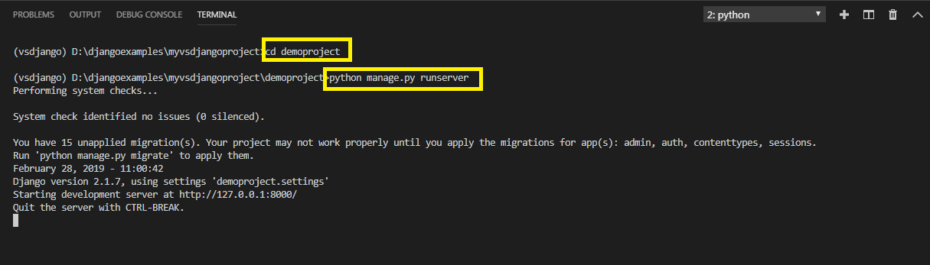
Step 5:Running The Server
To run our new greetingsapp , go to the folder demoproject by using cd command and type the runserver command in VS Code terminal
cd demoproject
python manage.py runserver.
The server runs on the default port 8000, and we’llsee output like the following output in the terminal window:

Slide 35
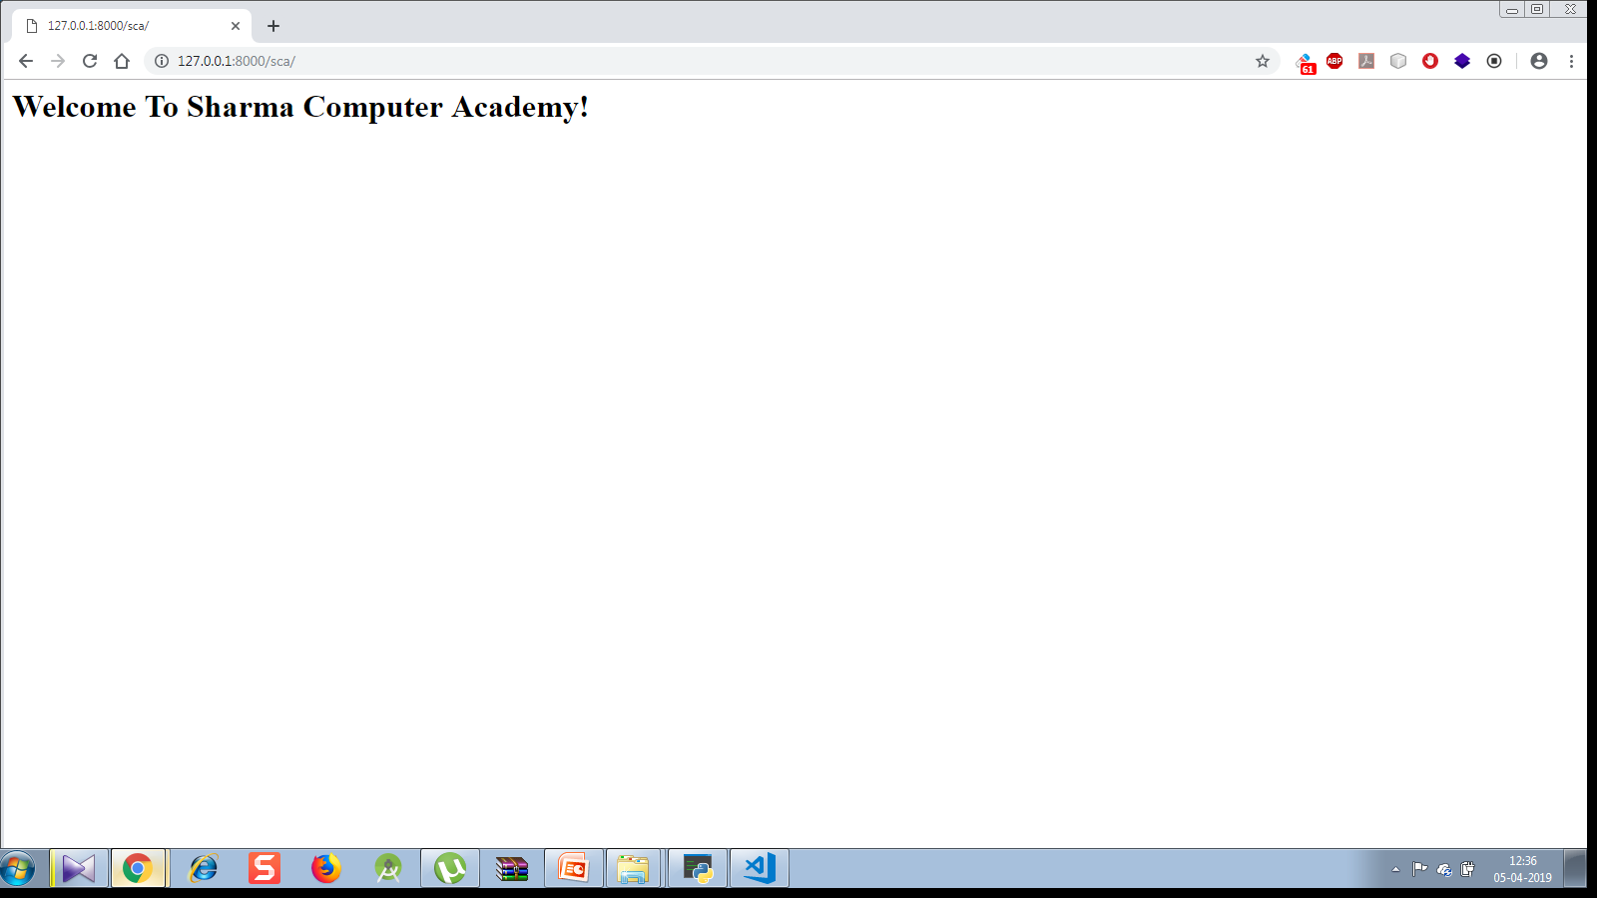
Step 6: Opening The Page
Type the http://127.0.0.1:8000/sca URL in browser to navigate to that
address. Now we should see a plain, but functioning home page

Slide 36
So What Just Happened ?
To better understand how Django works, let’s trace the entire set of activities that took place when we requested the url http://127.0.0.1:8000/sca
1. Our browser sent a message to the Django development server requesting it to return the content located at the URL (http:// 127.0.0.1: 8000/sca)
2.Django then looked for a URL pattern that matches the request, by first searching the site level urls.py and then each of the apps for a urls.py file containing a pattern that matches.
3. Django checks the first pattern (“admin/”) in our site level urls.py which doesn’t match, and moves on to the second line in which the string(‘sca/’) matches.

Slide 37
So What Just Happened ?
4. The matching pattern includes the urls.py from the greetingsapp app. Basically this include says “go look in the pages app for a pattern that matches”.
5. Now Django chops off sca/ and sends the remaining pattern which is an empty string to app level’s urls.py.
6. Once in the app-level urls.py, the search for empty string is done which matches again, but this time the request is sent to the homePageView view.
7. The homePageView() function/view then renders our simple HTML message to an HttpResponse that is sent to the browser.
8.The browser renders the response and we see our page output.
Every Django application follows this same basic process each time it receives a request from the browser.

Slide 38
Some More URL Pattern Matching
Suppose we want that if the request is http://127.0.0.1:8000/sca or http://127.0.0.1:8000 , in both the cases our homePageView( ) function should run .
Can you tell what should be done for this ?

Slide 39
Some More URL Pattern Matching
There are 2 solutions to this:
Solution 1
We can make 2 entries in the project level urls.py as shown below:
path('',include('greetingsapp.urls')),
path('sca/',include('greetingsapp.urls')),
In this way on both the kinds of url , Django will first chop off the url mentioned in path() function and send the remaining part to the app level urls.py.
In the app level urls.py we need to change nothing as in both the cases it will receive the empty string which will match with the following:
path('', views.homePageView, name =' index'),

Slide 40
Some More URL Pattern Matching
Solution 2
In the project level urls.py we make just 1 entry which is:
path('',include('greetingsapp.urls')),
This tells Django that as soon as any request arrives at the domain 127.0.0.1:8000 it should be sent to app levels urls.py.
Now in the app level urls.py we can make 2 entries , as shown below:
path('', views.homePageView, name =' index'),
path('sca/', views.homePageView, name =' index'),
Now since Django will pass everything after the domain name (127.0.0.1:8000) to the app level urls.py so now both the requests ('' and sca/) will match with the entries in the app levels urls.py and will be redirected to homePageView() function

Slide 41
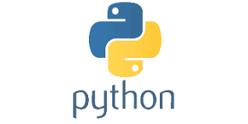
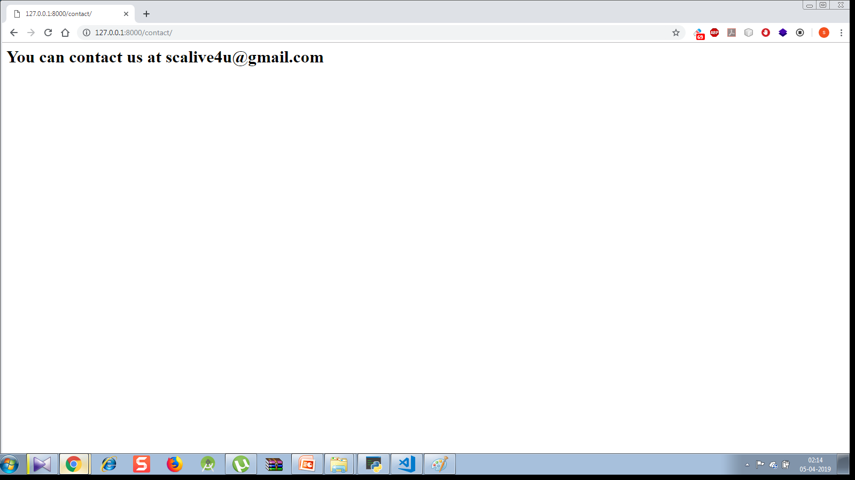
Exercise
Modify the previous app so that if a url arrives as http://127.0.01:8000/contact then the message You can contact us at scalive4u@gmail.com should appear
Output:

Slide 42
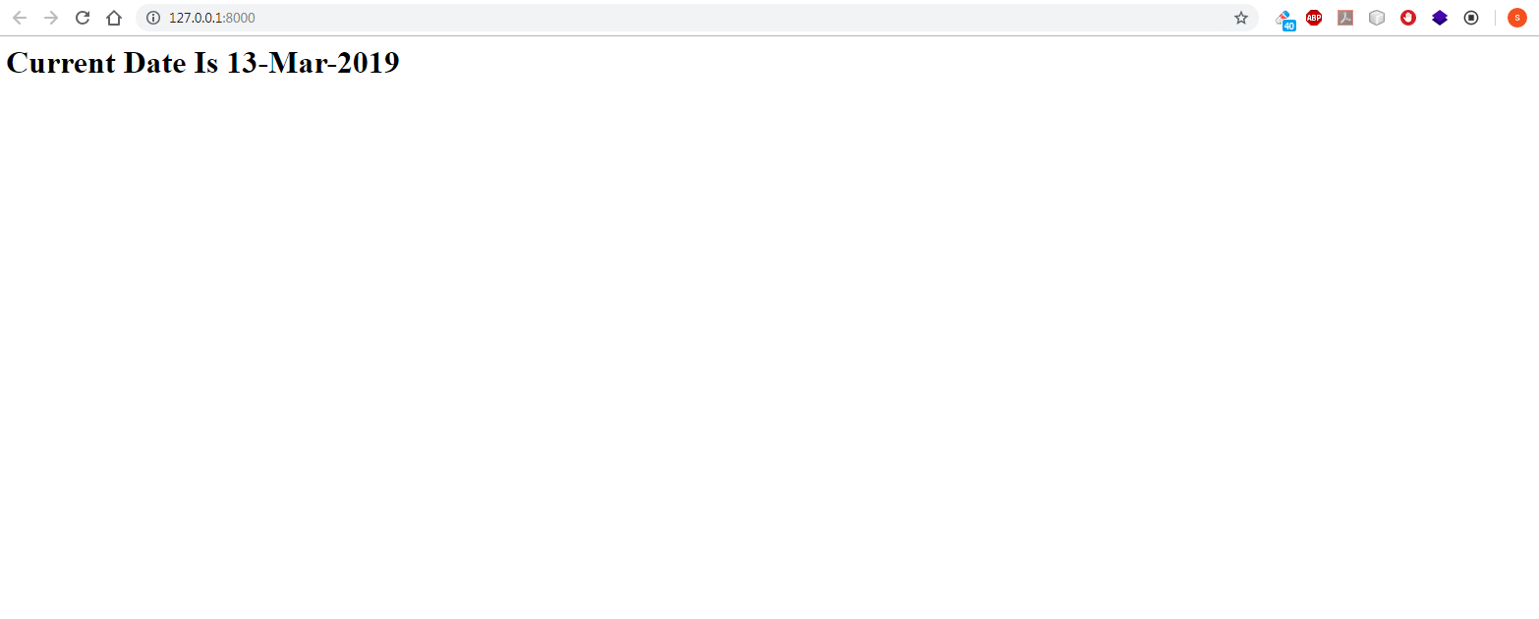
Exercise
Write a Django App which displays current date as the user opens the index page
Output:

Slide 43
Exercise
Modify the previous App so that it now has 2 pages , one displays current date and the other displays current time. The url for date page should be showdate and for time page should be showtime

